Slide 1
Some Final-Project Topics 1. Deblur 2. Derain 3. Denoise 4. Dehaze 5. Desnow
https://www.mdpi.com/2072-6694/15/14/3608

Slide 2
Approaches
Find codes in Github
Use Colab or Kaggle to implement the codes in Github
Apply to the self-made images
Show the results

Slide 3
Example 1
Restoring Vision in Adverse Weather Conditions with Patch-Based Denoising Diffusion Models
Present a novel patch-based diffusive image restoration algorithm for arbitrary sized image processing with denoising diffusion models.
https://github.com/IGITUGraz/WeatherDiffusion

Slide 4
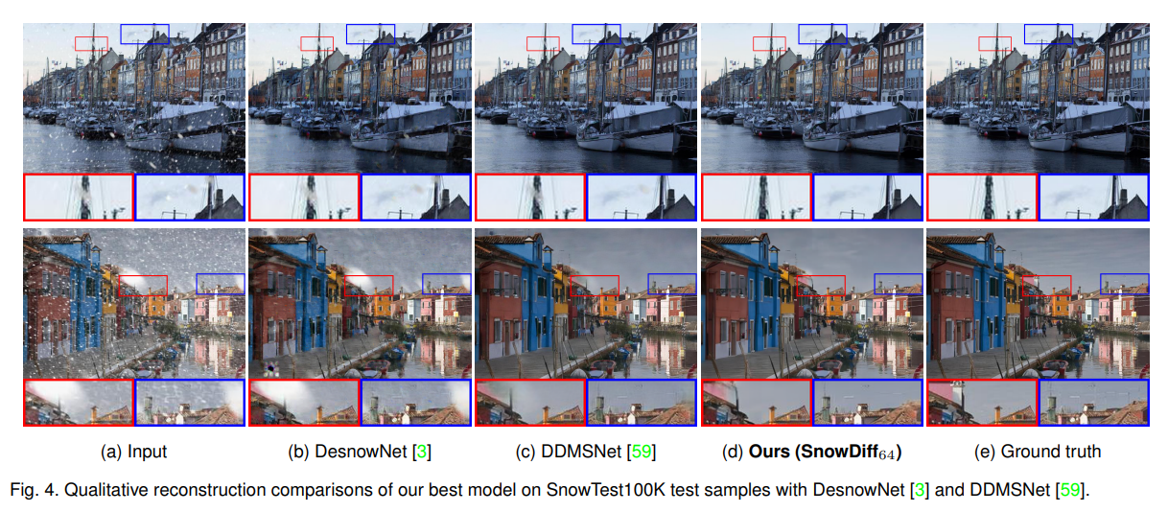
Example 1

Slide 5
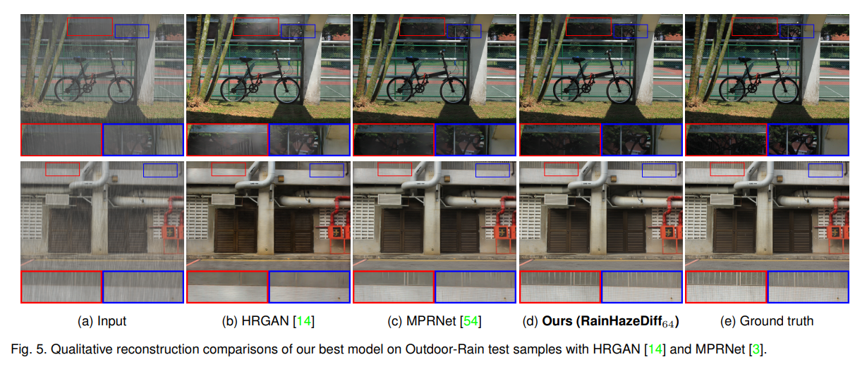
Example 1

Slide 6
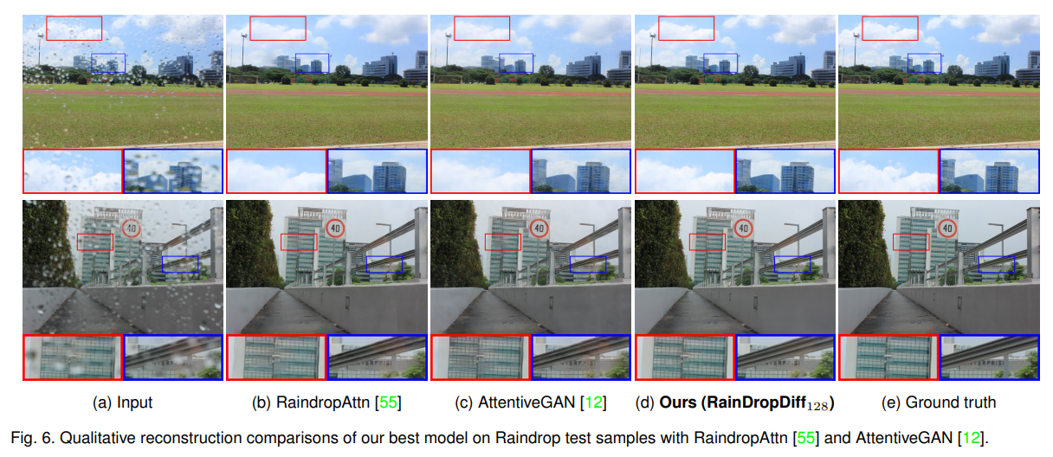
Example 1

Slide 7
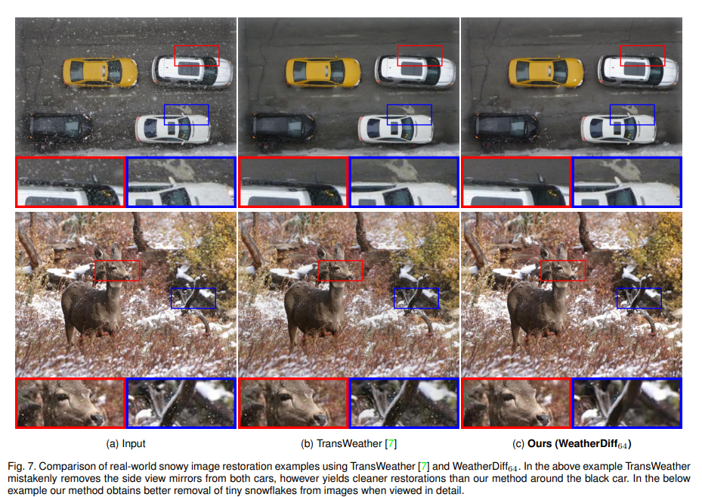

Slide 8
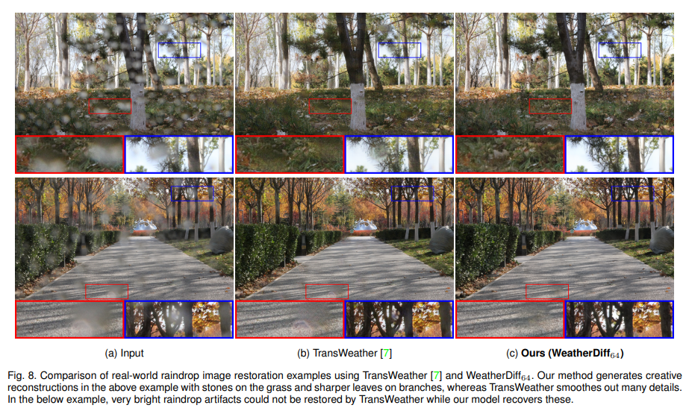

Slide 9
Example 2
Restormer: Efficient Transformer for High-Resolution Image Restoration
Propose Restormer, an encoder-decoder Transformer for multi-scale local-global representation learning on high-resolution images without disintegrating them into local windows, thereby exploiting distant image context.
https://github.com/swz30/Restormer

Slide 10
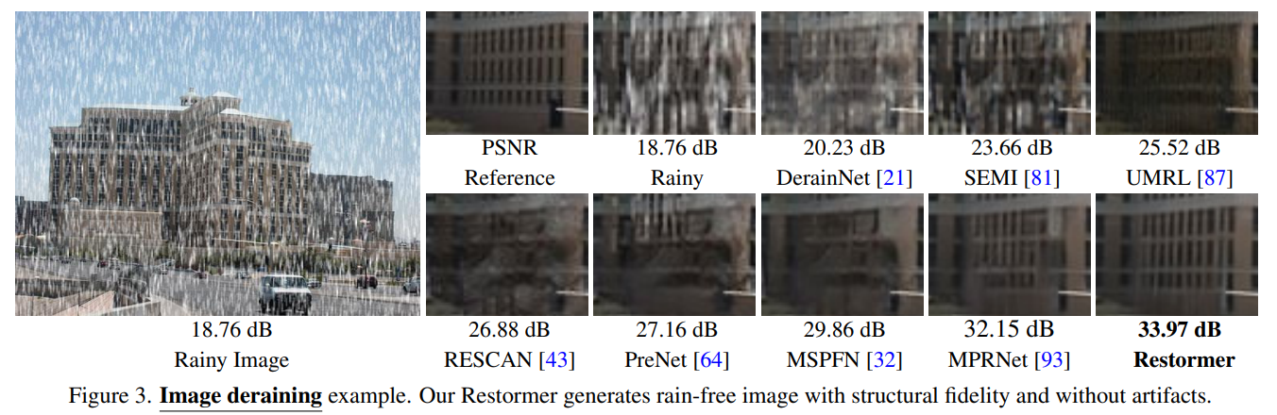
Example 2

Slide 11
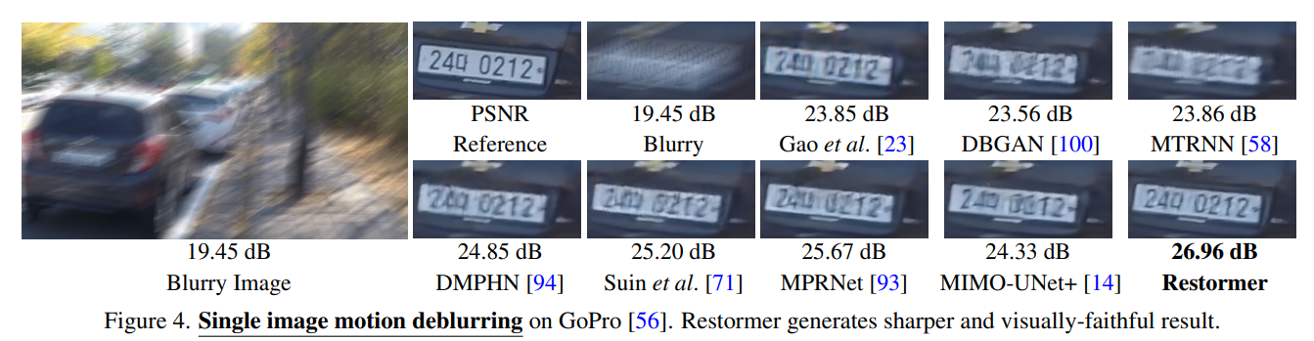
Example 2

Slide 12
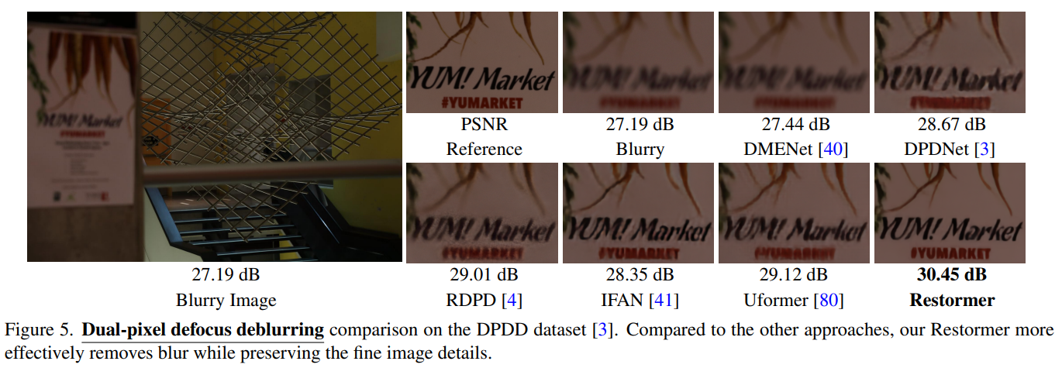
Example 2

Slide 13
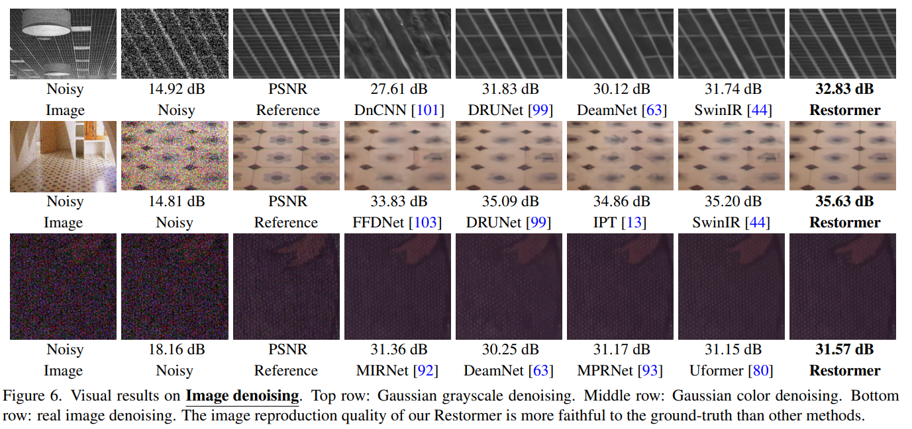
Example 2

